Slide 1



An Active Learning Approach For Inferring Discrete Event Automata
Mohammad Mahdi Karimi
PhD. Candidate, ECE
Supervisor: Dr Ali Karimoddini
Summer 2015

Slide 2
Content
Discrete Event Systems
Definitions
Applications
Automata Theory
Language
Regular Language
Automata Representation
Modeling in Automata
L^{star} Learning
Definitions
Algorithm
UAV Example
L^{star} Features
L^{star} Matlab Toolbox
Conclusion

Slide 3
Section 1: Discrete Event Systems
Definitions and Applications

Slide 4
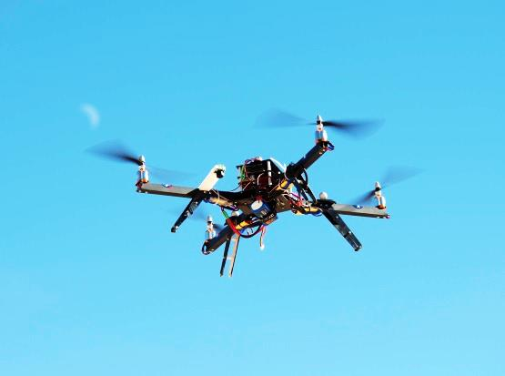
What is DES?
Discrete Event Systems:
Deﬁnition: A Discrete Event System (DES) is a discrete-state, event-driven system, that is, its state evolution depends entirely on the occurrence of asynchronous discrete events over time.
Start mission
Low fuel
L,R
Hangar Mode
Mission Mode
S
Emergency Mode
Return to Hangar
L,S,R

Slide 5
Motivation, Why DES?
To treat large-scale systems we need an abstract and simple tool:
DES can effectively model large scale systems in an abstract mathematical fashion.
DES can capture system’s logics and rules and used for constructing the decision making units of systems.
Many systems are inherently DES (Ex. Queuing system)
Many others can be abstracted to DES (Ex. Robotic)

Slide 6
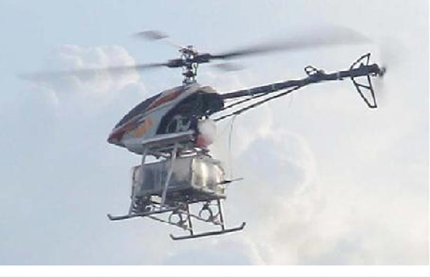
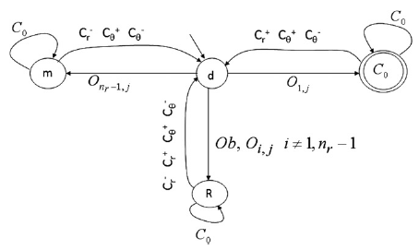
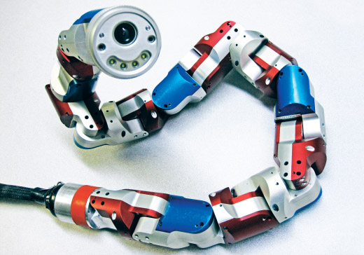
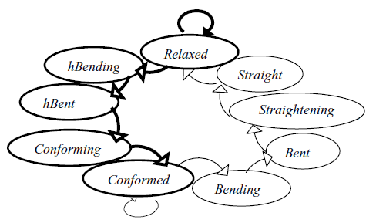
Some DES Examples
Unmanned Arial Vehicles
Robotic applications
-Karimoddini, Ali, et al. "Hybrid formation control of the unmanned aerial vehicles." Mechatronics 21.5 (2011): 886-898.
-Tzionas, Panagiotis G., Adonios Thanailakis, and Philippos G. Tsalides. "Collision-free path planning for a diamond-shaped robot using two-dimensional cellular automata." Robotics and Automation, IEEE Transactions on 13.2 (1997): 237-250.

Slide 7
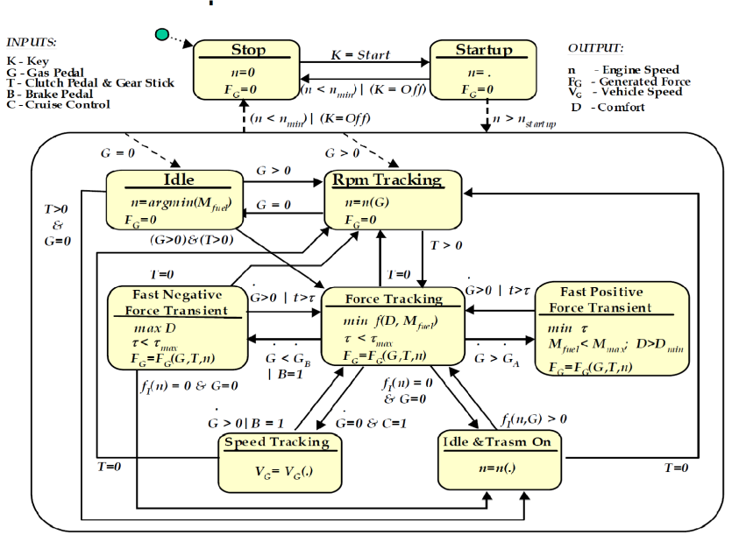
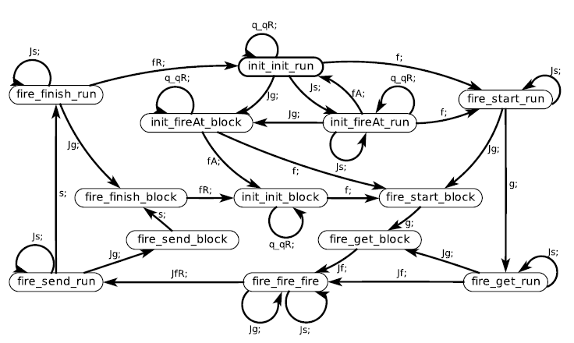
Some DES Applications
Power-train Specification
Internet Of Things(IOT):
Balluchi, Andrea, et al. "Automotive engine control and hybrid systems: Challenges and opportunities." Proceedings of the IEEE 88.7 (2000): 888-912.
Lohstroh, Marten, Lee, Edward A., “An Interface Theory for the Internet of Things.” 13th International Conference on Software Engineering and Formal Methods (SEFM), 2015.

Slide 8
Automata Theory
Discrete Event Systems
Definitions
Applications
Automata Theory
Language
Regular Language
Automata Representation
Modeling in Automata
L^{star} Learning
Definitions
Algorithm
UAV Example
L^{star} Features
L^{star} Matlab Toolbox
Conclusion
Language and Automata

Slide 9
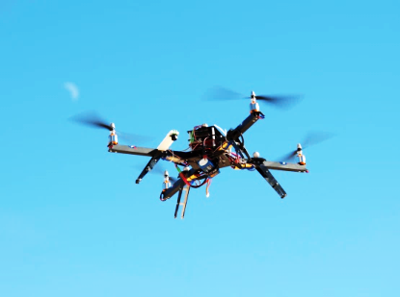
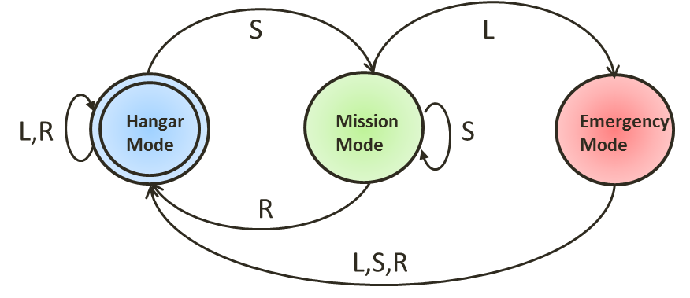
What is a Language?
Behavior of a deterministic DES can be equivalently described by the set of all possible sequences of events:
σ₁σ₂…
and the initial state X₀. Each such event sequence is called a trace or string of the system, and a collection of traces starting at X₀ and ending at final states is called a (marked) language.
L={L,R, SR, SLR,…}
Problem:
To describe a system with its language, we may come up with a set of infinite strings.
Kumar, Ratnesh, and Vijay K. Garg. Modeling and control of logical discrete event systems. Vol. 300. Springer Science & Business Media, 2012.

Slide 10
Regular Languages
Regular language is a class of language. In regular languages, a language is an infinite set, but it can be represented using finite state machines (Automata).
Theorem:
Given a regular language model (K_{m},K), there exists a DFSM, G=(X,∑,α,x₀,X_{m}), such that (L_{m}(G),L(G))=(K_{m},K).
It is proved that for any given regular language there is a DFSM,
Question is now how to represent model in more graphical way?
Kumar, Ratnesh, and Vijay K. Garg. Modeling and control of logical discrete event systems. Vol. 300. Springer Science & Business Media, 2012.

Slide 11
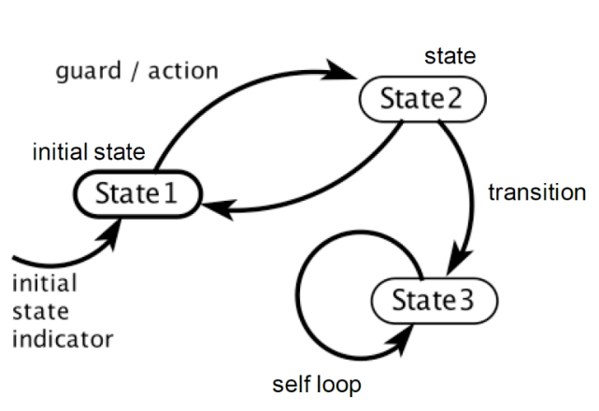
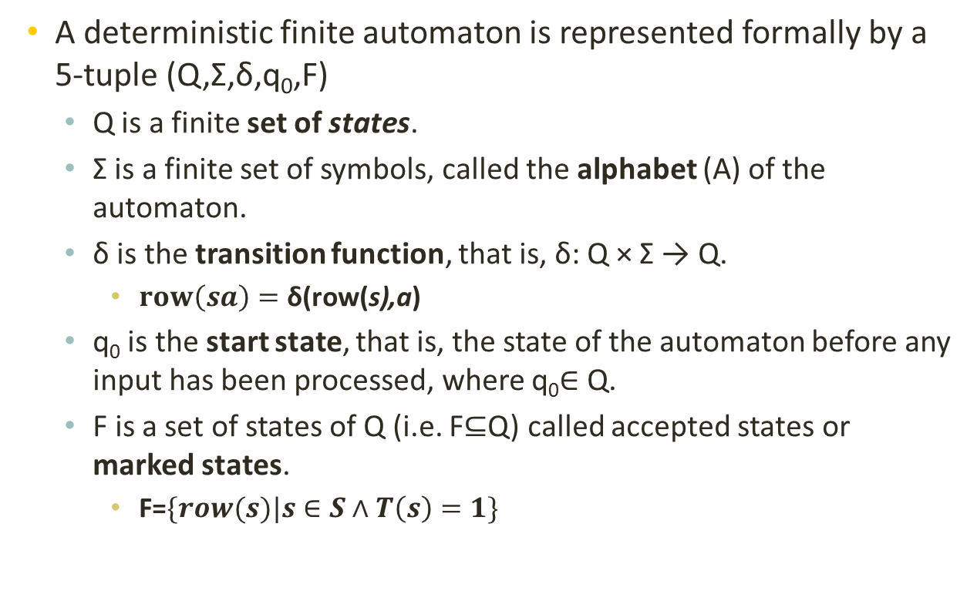
Automata Representation
A deterministic finite automaton is represented formally by a 5-tuple (Q,Σ,δ,q₀,F)
Q is a finite set of states.
Σ is a finite set of symbols, called the alphabet (A) of the automaton.
δ is the transition function, that is, δ: Q × Σ → Q.
$row\left(sa\right)=\text{δ}\text{(}\text{row}\text{(}\text{s}\text{),}\text{a}\text{)}$
q₀ is the start state, that is, the state of the automaton before any input has been processed, where q₀∈ Q.
F is a set of states of Q (i.e. F⊆Q) called accepted states or marked states.
F=$\{row(s)|s∈S∧T\left(s\right)=1\}$
Problem:
How to model a system by an Automaton.

Slide 12
How to model system with Automata
Analytical modeling
All information about the system is available in the form of a language and we try to build a DFSM out of given strings. (e.g. Myhill-Nerode construction method)
Question:
How about the case we do not have information about the system? We need to learn the system.
Learning techniques
Passive Learning: | Active Learning:

Slide 13

Passive Learning Approach:
Teacher provides abounding number of examples
Learner fit a model for the provided examples.
The learner passively learns the trained information and only can work on the training range.
Question:
How about the case that a new situation happens and the learner is not trained for it?

Slide 14
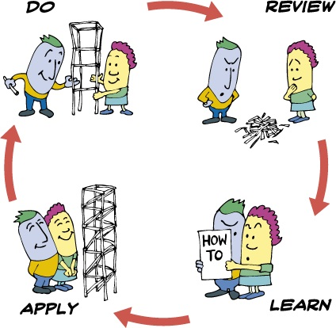
Active Learning Approach:
Imagine we don’t have information about the system and we do not have access to the system.
In this method, the learner tries to actively build the model by asking minimal questions from a teacher.
The teacher is an expert person who can answer the learner’s questions about the system.
L^{star} Learning is and example of
active learning

Slide 15
L^{star} Learning
Discrete Event Systems
Definitions
Applications
Automata Theory
Language
Regular Language
Automata Representation
Modeling in Automata
L^{star} Learning
Definitions
Algorithm
UAV Example
L^{star} Features
L^{star} Matlab Toolbox
Conclusion
Algorithm and UAV Example

Slide 16
L^{star} Learning
The L^{star} algorithm has introduces by Angluin in 1987.
This technique actively identifies an unknown regular language, and generates a minimum state Deterministic Finite Automata (DFA).
It is assumed that the regular set is available to a minimally adequate Teacher which can answer the learners questions and validate the model.
The learner actively asks queries during the learning process to build an observation table and eventually comes up with conjecture set and DFSM.

Slide 17
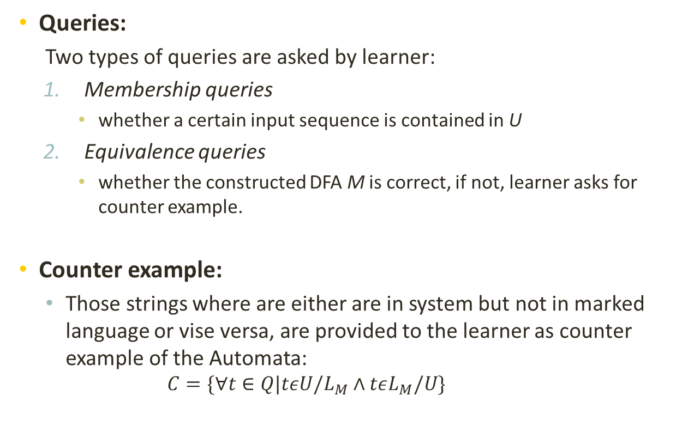
L^{star} learning
Queries:
Two types of queries are asked by learner:
Membership queries
whether a certain input sequence is contained in U
Equivalence queries
whether the constructed DFA M is correct, if not, learner asks for counter example.
Counter example:
Those strings where are either are in system but not in marked language or vise versa, are provided to the learner as counter example of the Automata:
$$C=\{∀t∈Q|tεU/L_{M}∧tεL_{M}/U\}$$

Slide 18
Cont.
W
S
S.A
Observation table consist of three sections:
a nonempty finite prefix-closed set S of strings
a nonempty finite suffix-closed set E of strings
a finite function T mapping ((S⋃S.A). E) to {0,1}
The interpretation of T is that T(u) is 1 if and only if u is a member of the unknown regular set, U.
Notes:
Prefix-Closed: every prefix of every member of the set is also a member of the set. Suffix-closed is defined analogously

Slide 19

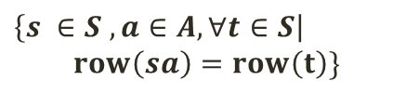

Consistency and Closeness
W
S
S.A
Consistent
An observation table is called consistent provided that whenever s₁ and s₂ are elements of S such that row(s₁) = row(s₂), for all a in A .
Closed
An observation table is considered closed if for each t in S.A there exists an s in S such that:
$$\left\{s_{1},s_{2}∈S , a∈A, w∈W\right|$$
$$row\left(s_{1}\right)=row\left(s_{2}\right)∨ T\left(s_{1}aw\right)=T(s_{2}aw)\}$$
$$\left\{s ∈S , a∈A, ∀t∈S\right|$$
$$row\left(sa\right)=row\left(t\right)\}$$
A
2
1
1
?
3
A

Slide 20
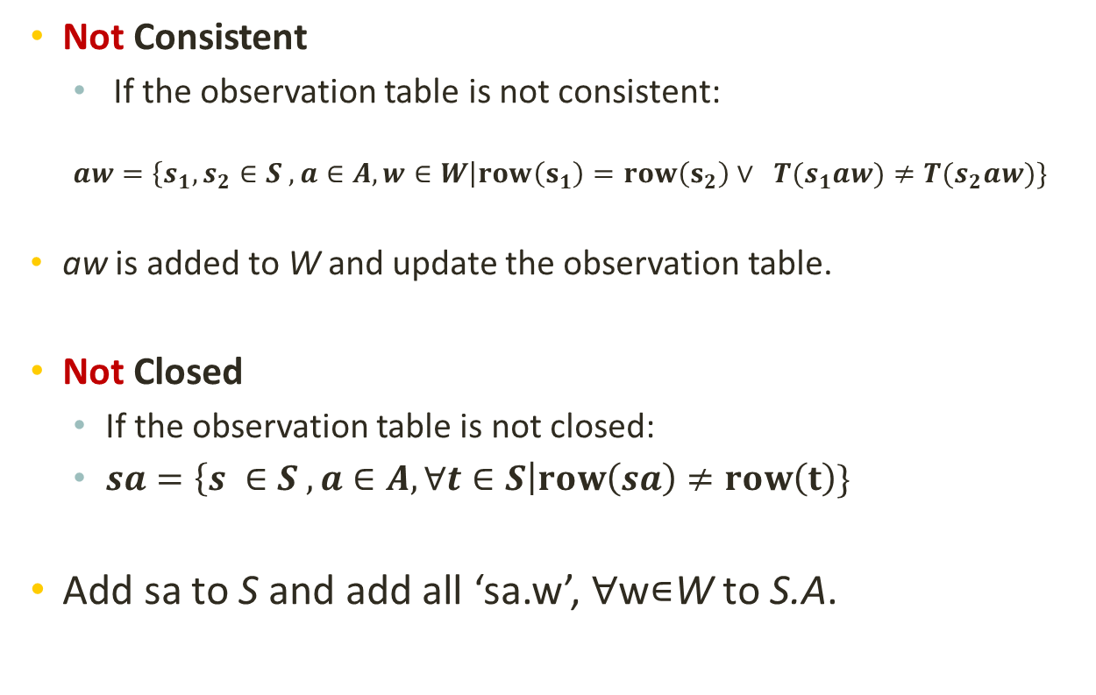
Solution
Not Consistent
If the observation table is not consistent:
$$aw=\left\{s_{1},s_{2}∈S , a∈A, w∈W\right|row\left(s_{1}\right)=row\left(s_{2}\right)∨ T(s_{1}aw)≠T(s_{2}aw)\}$$
aw is added to W and update the observation table.
Not Closed
If the observation table is not closed:
$sa=\left\{s ∈S , a∈A, ∀t∈S\right|row\left(sa\right)≠row\left(t\right)\}$
Add sa to S and add all ‘sa.w’, ∀w∊W to S.A.

Slide 21
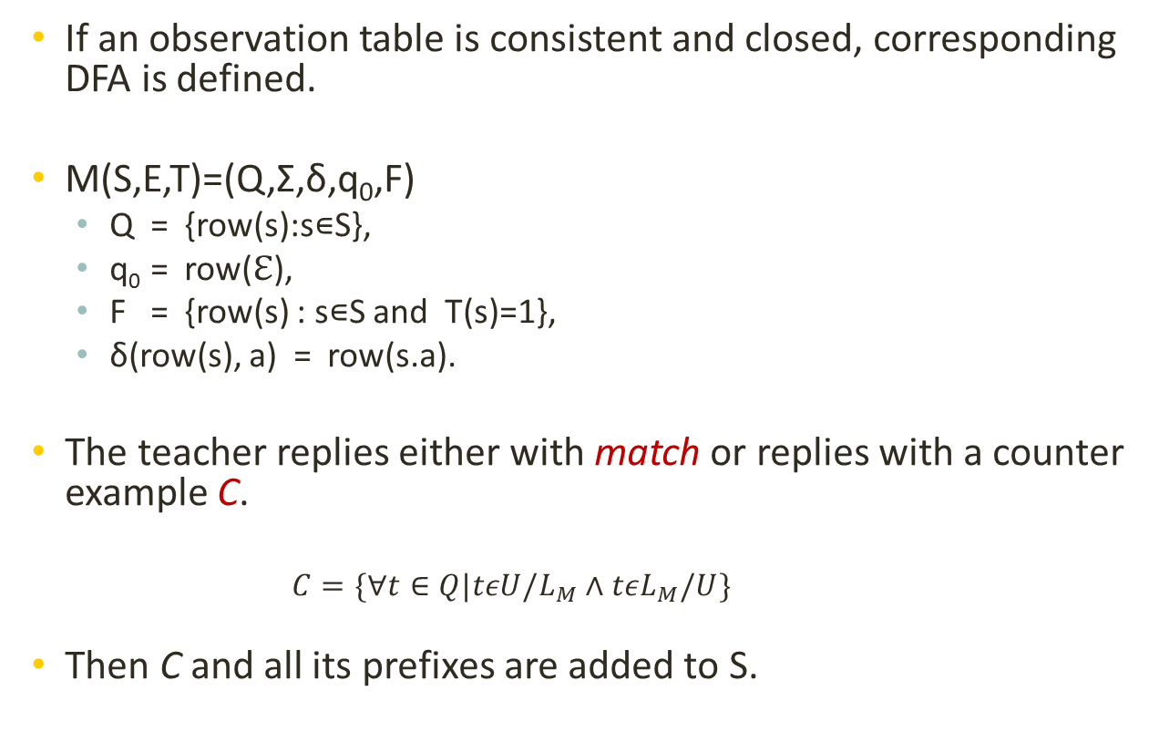
Counter Example
If an observation table is consistent and closed, corresponding DFA is defined.
M(S,E,T)=(Q,Σ,δ,q₀,F)
Q = {row(s):s∊S},
q₀ = row(ℇ),
F = {row(s) : s∊S and T(s)=1},
δ(row(s), a) = row(s.a).
The teacher replies either with match or replies with a counter example C.
$$C=\{∀t∈Q|tεU/L_{M}∧tεL_{M}/U\}$$
Then C and all its prefixes are added to S.

Slide 22
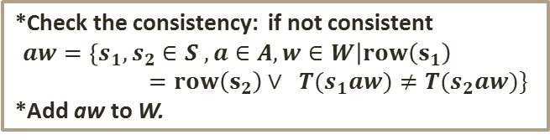
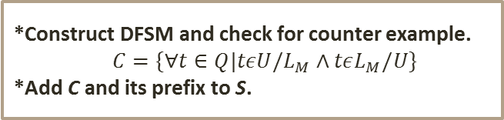
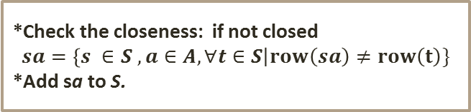
L^{star} Algorithm
Initializing observation table
*Check the consistency: if not consistent
$$aw=\left\{s_{1},s_{2}∈S , a∈A, w∈W\right|row\left(s_{1}\right)=row\left(s_{2}\right)∨ T(s_{1}aw)≠T(s_{2}aw)\}$$
*Add aw to W.
Until the OT is
consistent and closed
*Check the closeness: if not closed
$$sa=\left\{s ∈S , a∈A, ∀t∈S\right|row\left(sa\right)≠row\left(t\right)\}$$
*Add sa to S.
If counter example is provided
*Construct DFSM and check for counter example.
$$C=\{∀t∈Q|tεU/L_{M}∧tεL_{M}/U\}$$
*Add C and its prefix to S.
DFSM

Slide 23
UAV- Example
Consider the following example of UAV, Quadrator mission operation model. UAV receives commands to start its mission and return to hangar. But during the mission it may face with emergency condition and need to get back to hangar.
Assuming we don’t know the system, we will try to use Lstar learning to actively generate corresponding Automata.
S
L
L,R
Hangar Mode
Mission Mode
S
Emergency Mode
R
S: Start mission
R: Return to hangar
L: Low fuel alarm
L,S,R

Slide 24



UAV, Example:
Step 1:
S:
Starting with the initial observation table with empty string.
S={λ}
S.A:
Considering A={S, L, R} the S.A is :
S.A={S, L, R}
Analyze:
Table is not closed due to the row(S) from S.A which does not have similar row in S.
Action:
Adding row(S) to S

Slide 25
UAV, Example:
Step 2:
S:
String S is added
S={λ, S}
S.A:
S.A={L, R, SL, SS, SR}
Analyze:
Table is now closed and consistent.
Action:
Generating the DFSM and asking for any existing counter example.
Counter example:
C={SLL}
S
L,R
State 1
State 2
L,S
R

Slide 26
Ex. Cont.
Step 3:
S:
String SLL and its prefix strings are added
S={λ, S, SL, SLL}
S.A:
S.A={L, R, SL, SS, SR, SLS, SLR, SLLL, SLLS, SLLR}
Analyze:
Table is not consistent :
row(S) = row(SL) but T(SL) ≠ T(SLL).
Action:
Adding L to event column and update the table.

Slide 27
Ex. Cont.
Step 2:
S:
No change.
S.A:
No change.
Analyze:
Table is now closed and consistent.
Action:
Generating the DFSM and teacher approves the model, replies match.
S
L
L,R
State 1
State 2
S
State 3
R
L,S,R

Slide 28
Section 4: L^{star} Learning Features
Discrete Event Systems
Definitions
Applications
Automata Theory
Language
Regular Language
Automata Representation
Modeling in Automata
L^{star} Learning
Definitions
Algorithm
UAV Example
L^{star} Features
L^{star} Matlab Toolbox
Conclusion
Theorems and Proofs

Slide 29
L^{star} Learning Features
Constructed DFA with L^{star} learning is minimal. Any other DFA consistent with T, would have more than or equal number of states.
Any DFA consistent with T, with the same number of states is isomorphic with M.
Total number of operation is at most n-1
since there is initially at least one value of row(s) and there cannot be more than n. (n is number of states)
L* terminates after making at most n conjectures and executing its main loop a total of at most n - 1 times.
Angluin, Dana. "Learning regular sets from queries and counter examples. "Information and computation 75.2 (1987): 87-106.

Slide 30
Any other DFA consistent with T, would have more than or equal number of states.
Proof:
Proof is by contradiction, we assume that there exists a closed and consistent acceptor M’ has less than or equal number of states
We will show in order for M’ to be consistent with T it must have at least n states

Slide 31
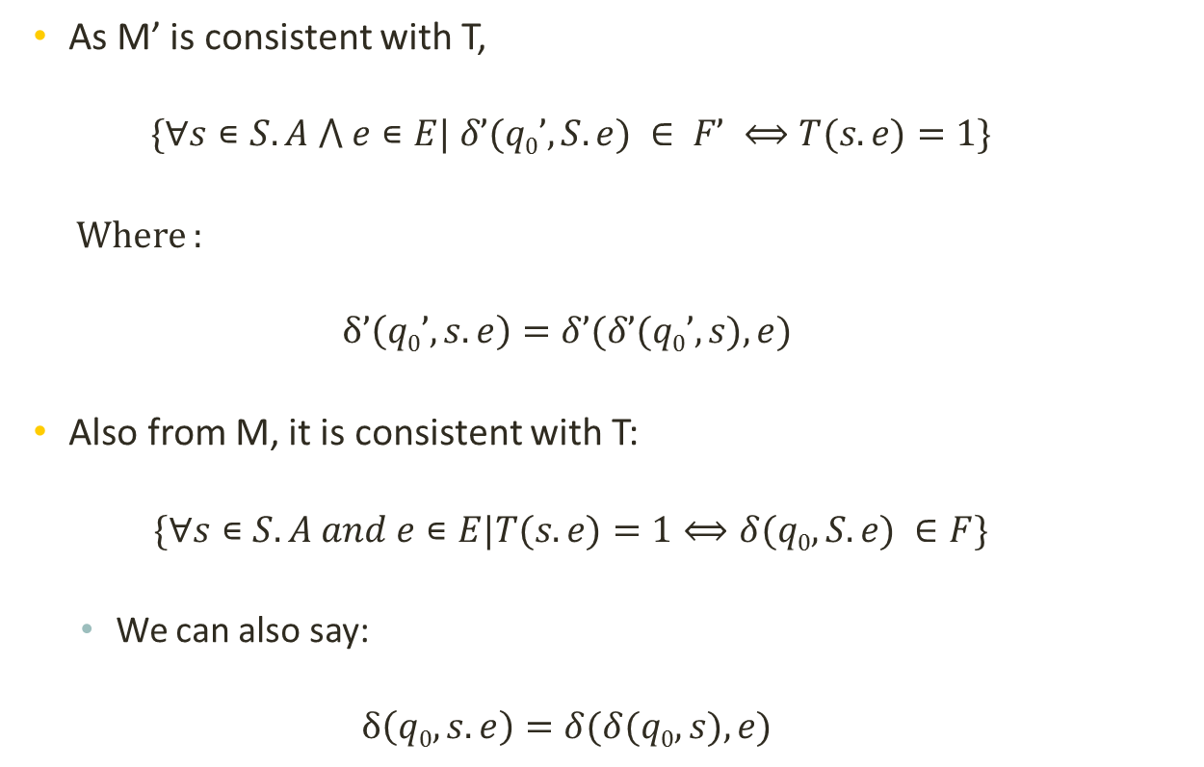
Proof Cont.
As M’ is consistent with T,
$$\{∀s∊S.A ⋀ e∊E| δ’(q0’, S.e) ∈ F’ ⟺T(s.e)=1\}$$
Where :
$$δ’\left(q0’, s.e\right)=δ’(δ’(q0’, s),e)$$
Also from M, it is consistent with T:
$$\{∀s∊S.A and e∊E|T(s.e)=1⟺δ(q0, S.e) ∈F\}$$
We can also say:
$$δ\left(q0, s.e\right)=δ(δ(q0, s),e)$$

Slide 32
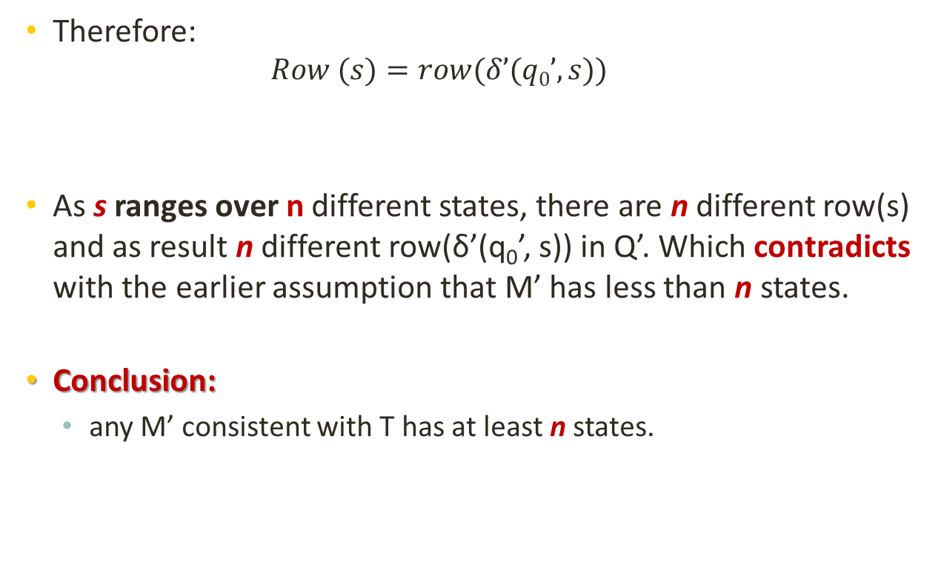
Proof Cont.
Therefore:
$$Row (s)=row(δ’(q0’, s))$$
As s ranges over n different states, there are n different row(s) and as result n different row(δ’(q₀’, s)) in Q’. Which contradicts with the earlier assumption that M’ has less than n states.
Conclusion:
any M’ consistent with T has at least n states.

Slide 33
Section 4: L^{star} Learning Toolbox
Theorems and Proofs

Slide 34
Matlab Toolbox
We developed a L^{star} learning Matlab toolbox.
UAV example
We have used the developed toolbox and came up with DFSM of the UAV system.

Slide 35
Section 5: Conclusion
Summary and Future Work

Slide 36
Summary
We introduced discrete event systems and their vast area of applications.
We provided different aspect of modeling techniques used for identifying DES systems.
We provided information about Automata representation
We discussed an application example of Automata for an UAV system.
We introduced Lstar Learning as an effective active learning approach for DES systems
Lstar Matlab toolbox is provided and tested with UAV example.

Slide 37
Future Work
Developing a learning technique for diagnosis of DES.
All of the existing techniques for fault diagnosis of DES assume perfect knowledge about the system.
We will try to develop a learning-based technique for diagnosis of unknown DES.
Developing learning technique for NFSM and corresponding fault diagnosing.

Slide 38
References
Angluin, Dana. "Learning regular sets from queries and counter examples."Information and computation 75.2 (1987): 87-106.
Kumar, Ratnesh, and Vijay K. Garg. Modeling and control of logical discrete event systems. Vol. 300. Springer Science & Business Media, 2012.
Karimoddini, Ali, et al. "Hybrid formation control of the unmanned aerial vehicles." Mechatronics 21.5 (2011): 886-898.
Lohstroh, Marten, Lee, Edward A., “An Interface Theory for the Internet of Things.” 13th International Conference onSoftware Engineering and Formal Methods (SEFM), 2015.

Slide 39
Other References
Cassandras, Christos G. Introduction to discrete event systems. Springer Science & Business Media, 2008.
Lee, Edward Ashford, and Sanjit Arunkumar Seshia. ”Introduction to embedded systems: A cyber-physical systems approach.” Lee & Seshia, 2011.
Nam, Wonhong, P. Madhusudan, and Rajeev Alur. "Automatic symbolic compositional verification by learning assumptions." Formal Methods in System Design 32.3 (2008): 207-234.
Ipate, Florentin. "Learning finite cover automata from queries." Journal of Computer and System Sciences 78.1 (2012): 221-244.

Slide 40


Thank you
Mohammad Mahdi Karimi
PhD. Candidate, ECE
Supervisor: Dr Ali Karimoddini
mmkarimi@aggies.ncat.edu

